Slide 1
Welcome!
Thank you for joining us. We’ll get started in a few minutes.
You must join the teleconference to hear the audio portion of the broadcast. You cannot listen through your computer. Dial:
1-866-708-1789
You will hear hold music until the broadcast begins. This is expected ☺
We will send the presentation and a recording of today’s broadcast to you within a few days after the session.

Slide 2
Tech Genius Webinar
Tuning
Todd Jaremko
Senior Project Engineer
20 October 2015

Slide 3
Agenda
Basic Regulator: KP and KI
Frequency Response: Gain Calculations
Filters: FIR, Lead-Lag, Notch
Load Observer/Inertia Adaption
Position Loop
Notes:
We are going to review basic regulator function and KP/KI. How they can be tuned.
Frequency Response and how it relates to the time domain
Filters/Filters and more filters
Load Observer/Inertia Adaption We don’t need no stinking filters
Position Loop
We are using the PF755 specifically, but the concept should be easily translated to the entire PowerFlex Family and even all Allen Bradley low voltage drives

Slide 4
Objectives
Understand the Basics of AB Drive Regulator Tuning
Be Comfortable in adjusting parameters

Slide 5
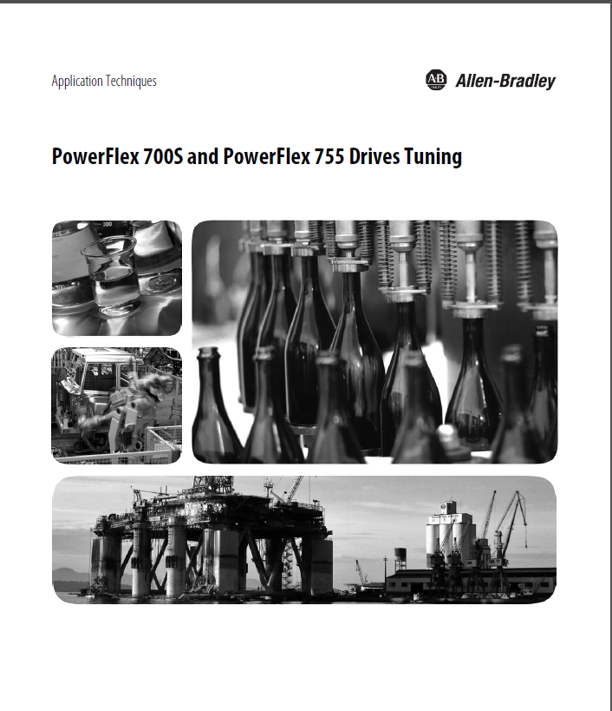
Good Manual: Drives-AT004A
Notes:
This is a great manual that the commercial engineering team put together. And it gives step by step examples of how to accomplish what we are discussing today.

Slide 6
Agenda
Basic Regulator: KP and KI
Frequency Response: Gain Calculations
Filters: FIR, Lead-Lag, Notch
Load Observer/Inertia Adaption
Position Loop
Notes:
Let’s go

Slide 7
Regulator
Reference
Output
+
Controller
F
e
e
d
b
a
c
k
Notes:
Building Blocks of a Regulator
Reference
Feedback
Error
Controller
Output

Slide 8
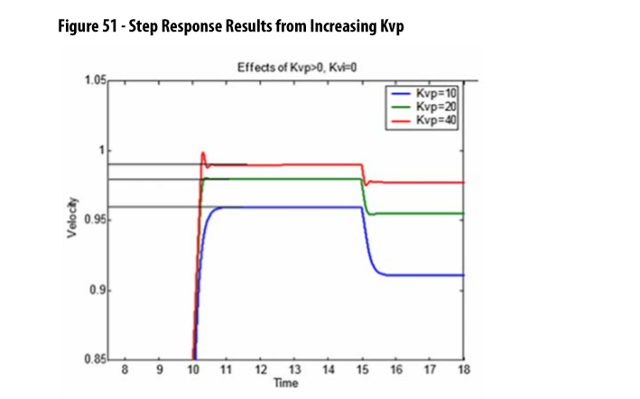
Proportional Only
Steady State Error
Doubling Proportional term reduces the steady state error by ½
Responsible for the depth of the speed deviation on a load change
Notes:
Just read the chart, slowly

Slide 9
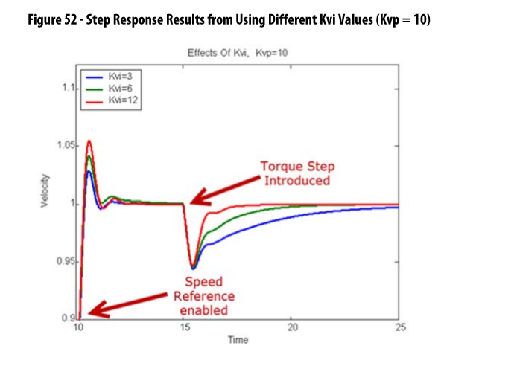
Adding Integral Term
Reduces Steady State Error to zero!
Decreases the recovery time after a load disturbance
Causes overshoot and ringing
Notes:
Read Slowly

Slide 10
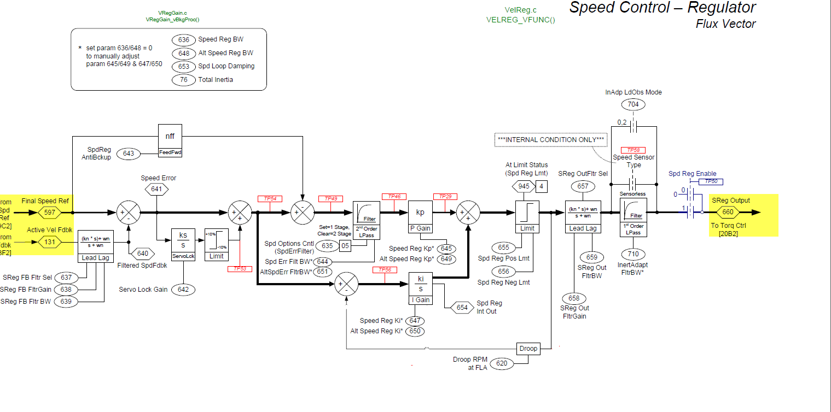
PF755 Velocity Regulator
Notes:
Here is the block diagram.
Reference Final Speed Reference
Feedback Active Velocity Feedback
Speed Regulator Output

Slide 11
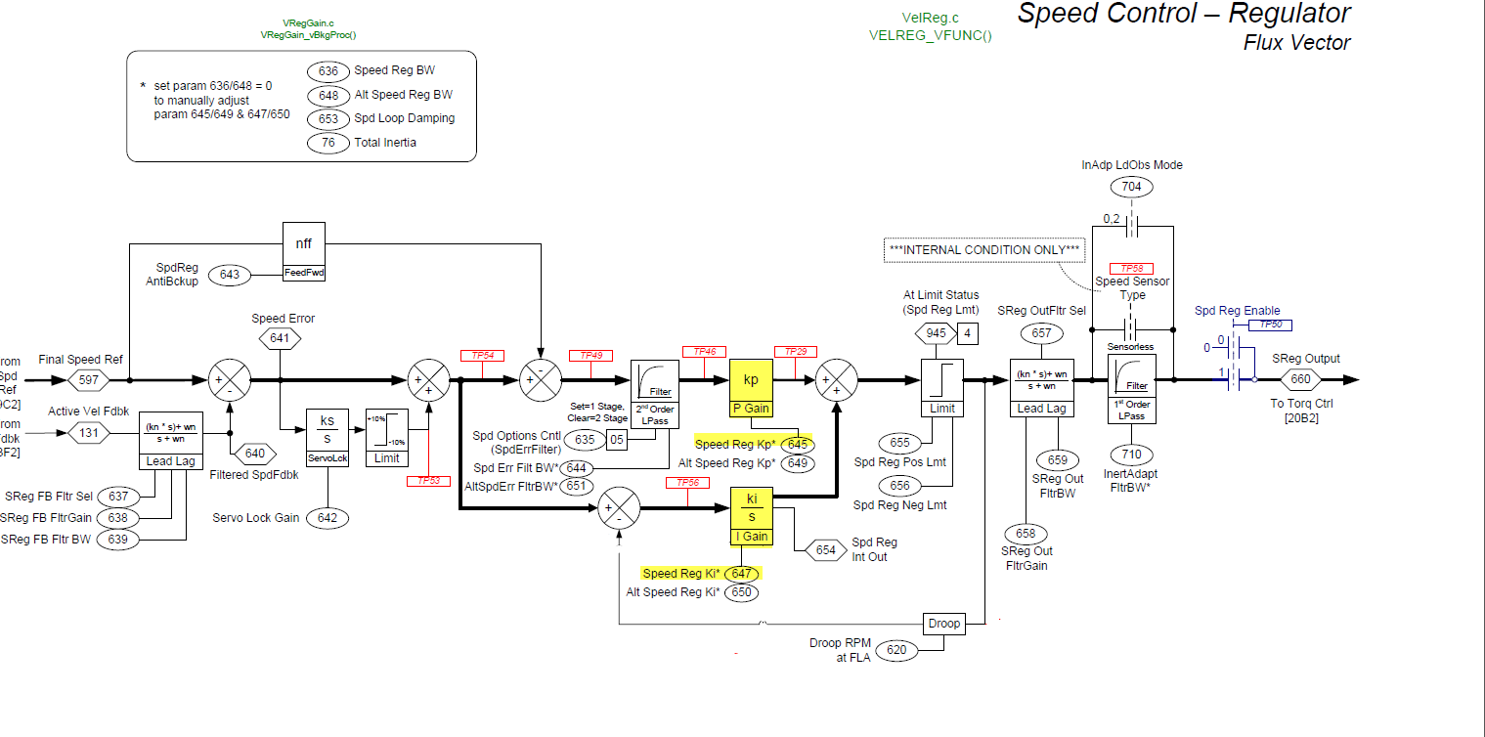
KP and KI
Notes:
KP P645
KI P647
What is not shown in the block diagram is a scaling block that per unitizes the gain
With a gain of one. The controller will have 100% output if there is 100% of error.
100% of error is defined as an error equal to base speed of the motor i.e 1780 rpm etc.

Slide 12
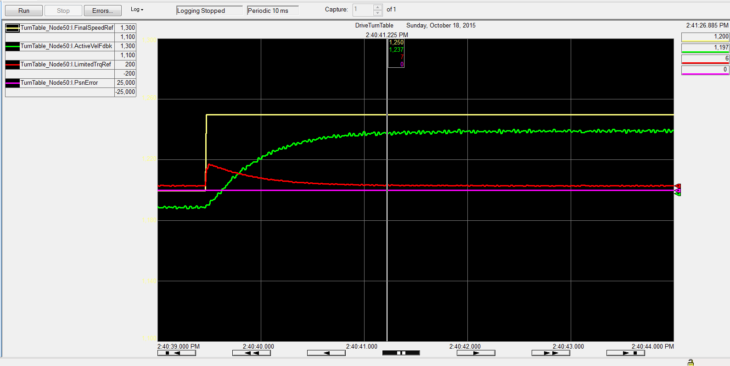
KP =10 KI=0
Notes:
To properly tune you must be able to see the reference,feedback and output.
One of the best methods is to use RS5K trending
13 rpm of error

Slide 13
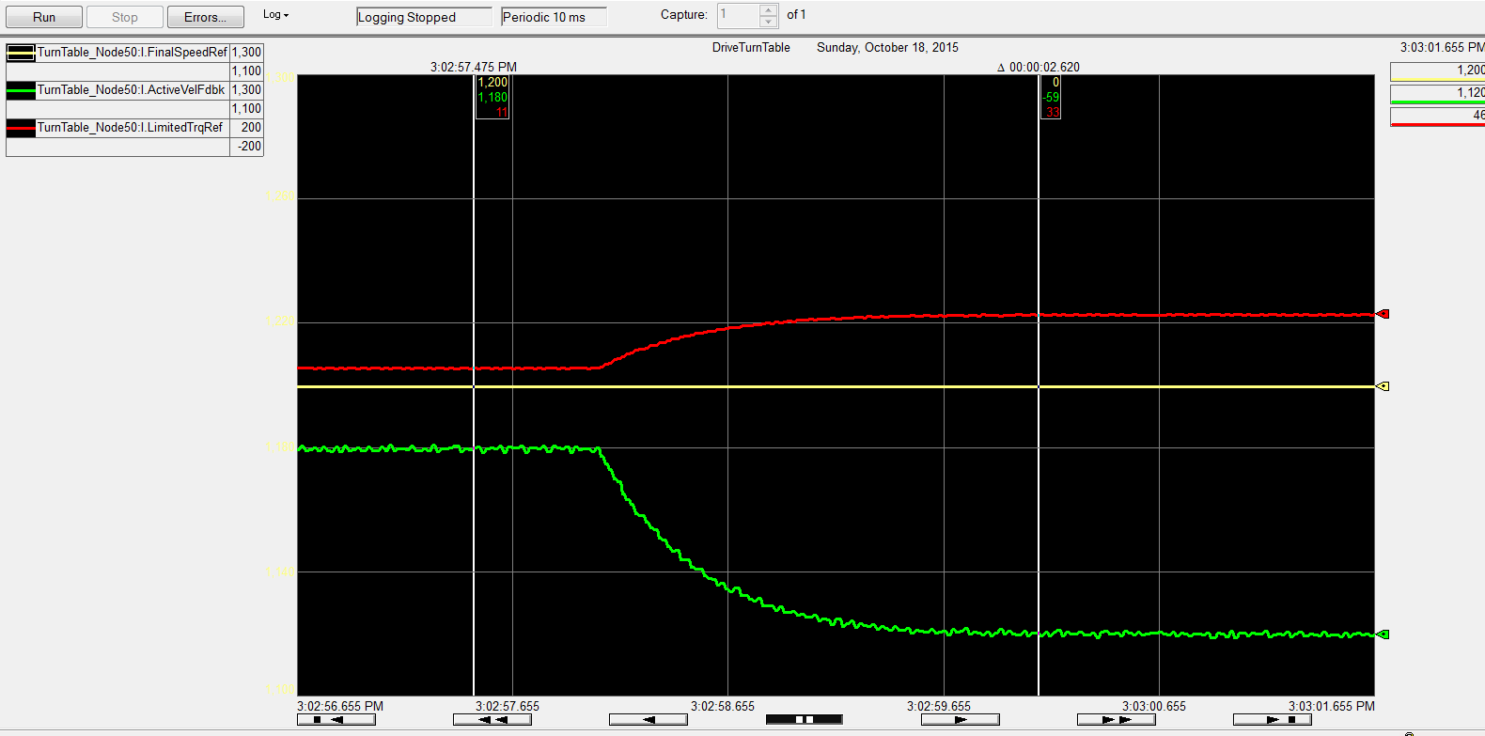
KP =10 KI=0
Notes:
Speed deviation 60 rpm

Slide 14
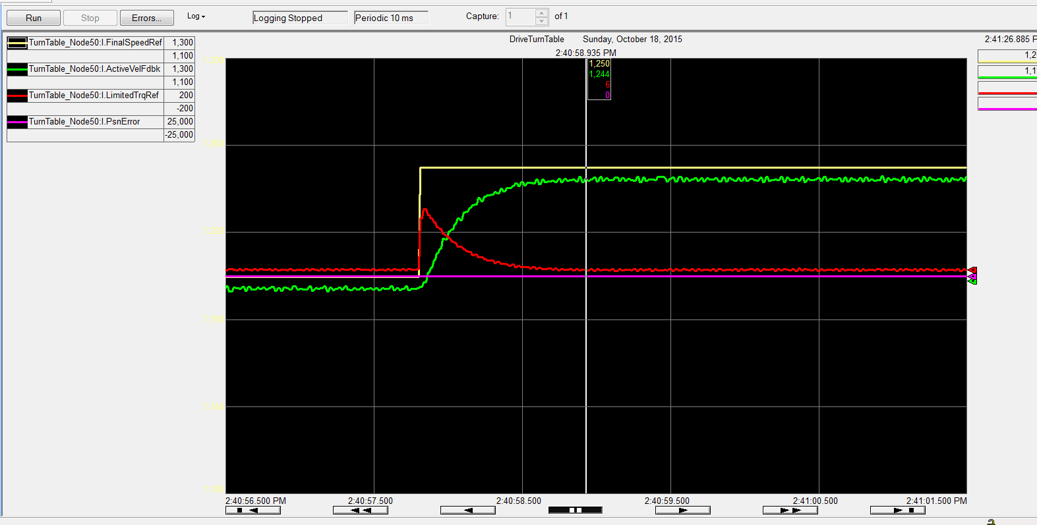
KP=20 KI=0
Notes:
6 rpm of error

Slide 15
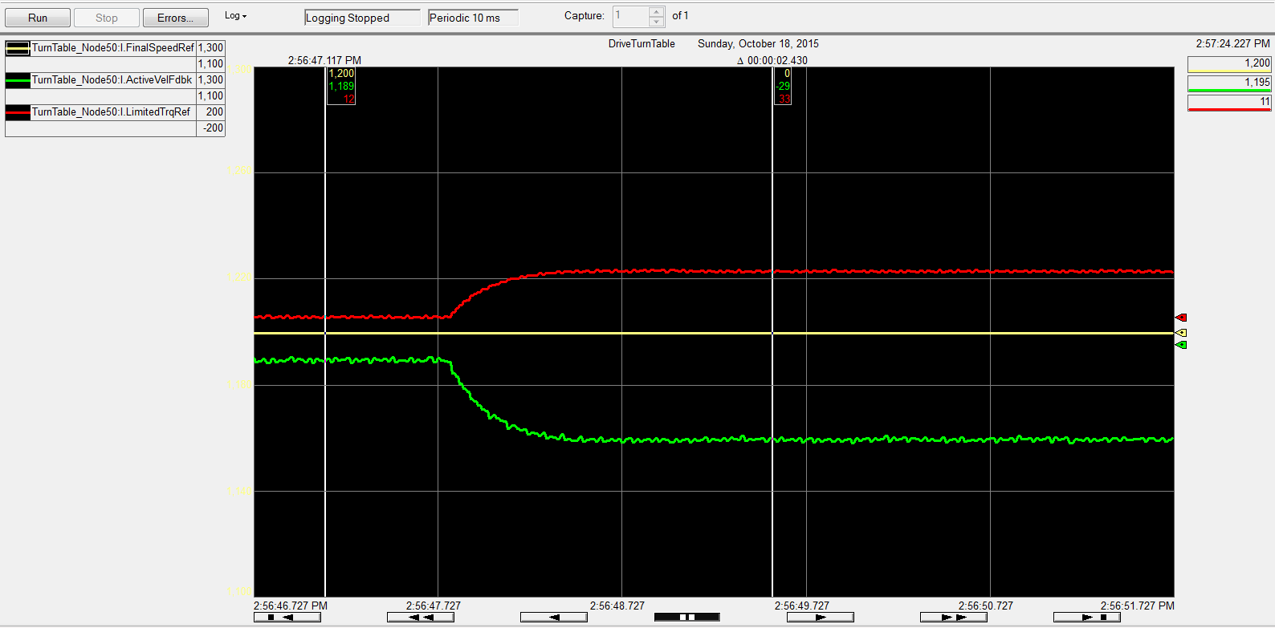
KP=20 KI=0
Notes:
30 rpm of deviation

Slide 16
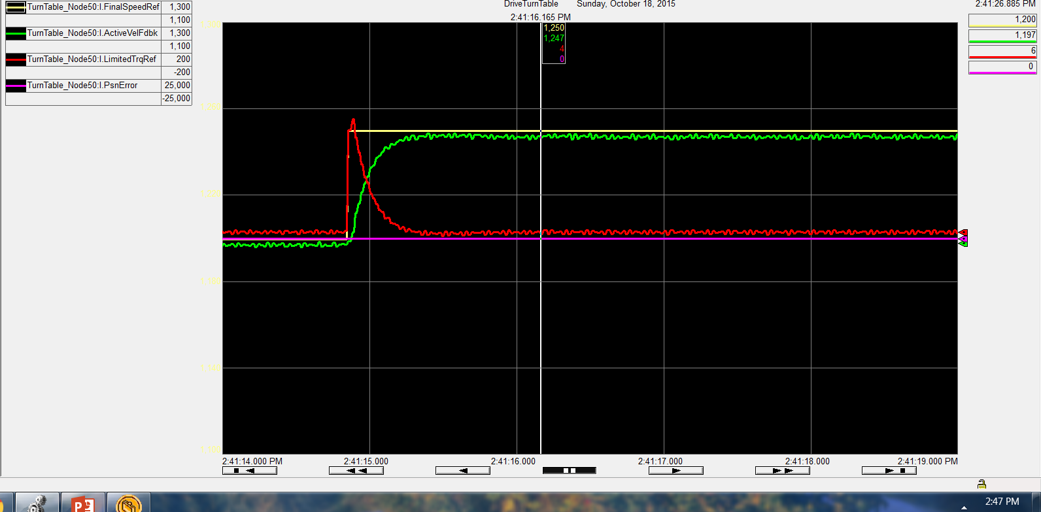
KP=40 KI=0
Notes:
3 rpm of error

Slide 17
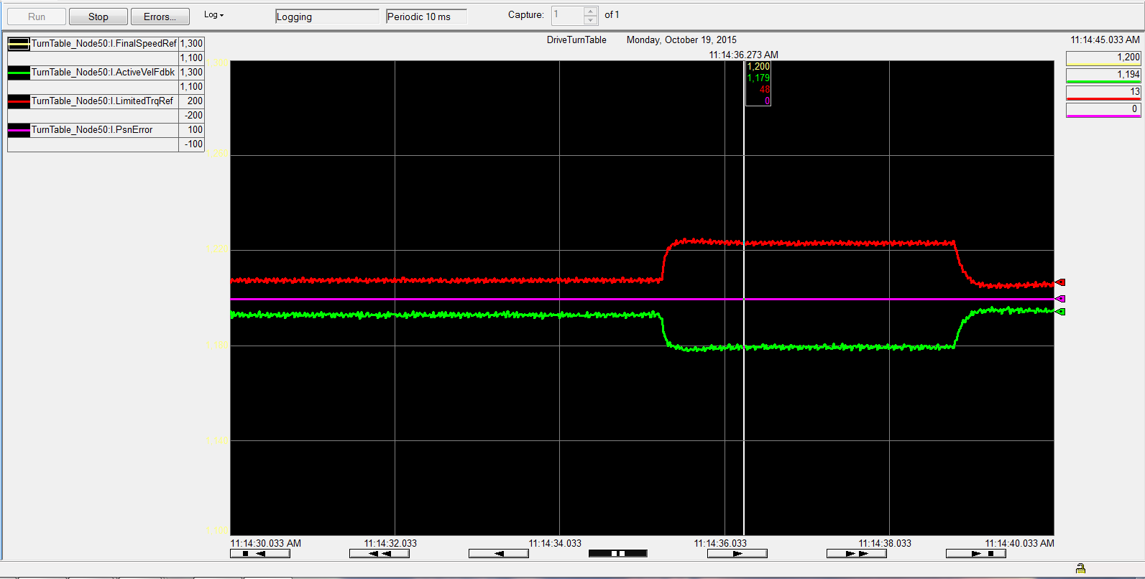
KP=40 KI=0
Notes:
20 rpm

Slide 18
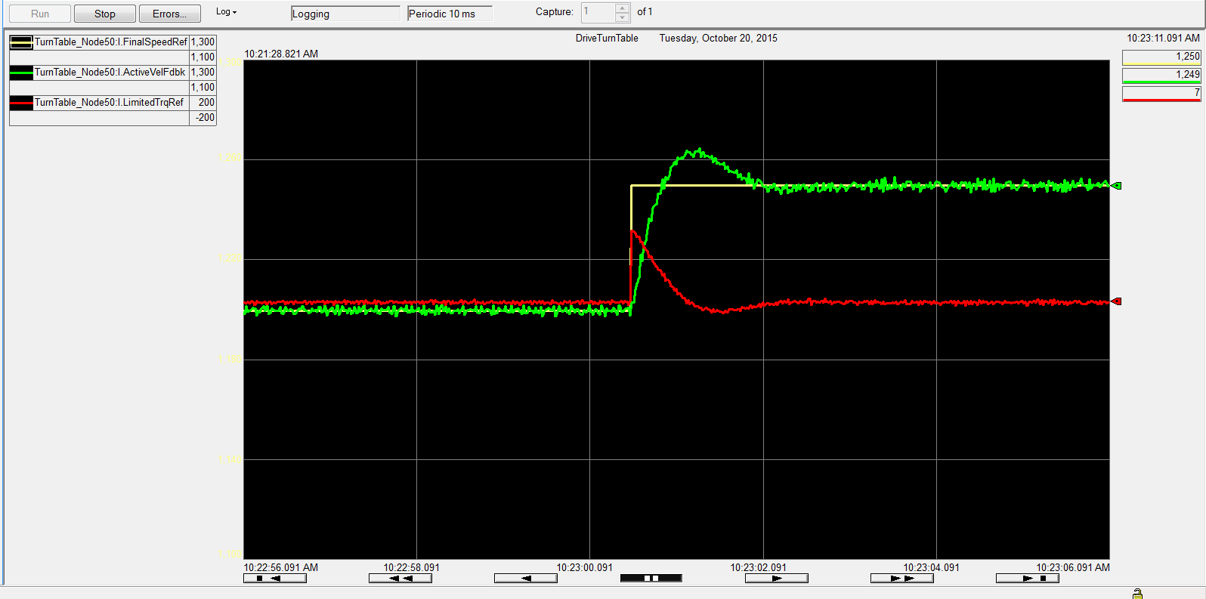
KP=20 KI=50
Notes:
No steady state error!!

Slide 19
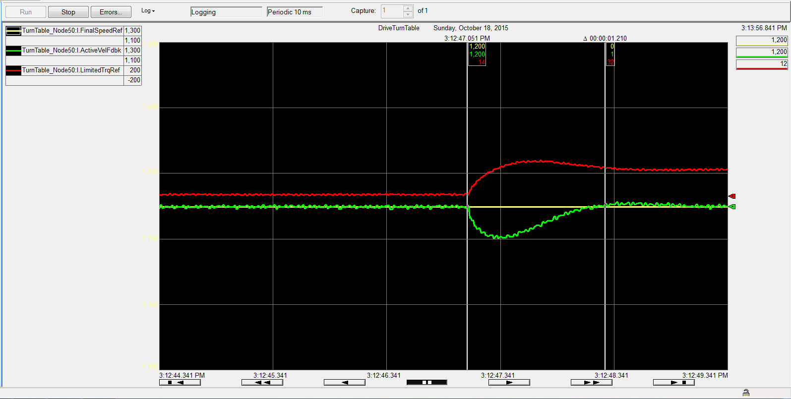
KP=20 KI=50
Notes:
Relatively quick recovery

Slide 20
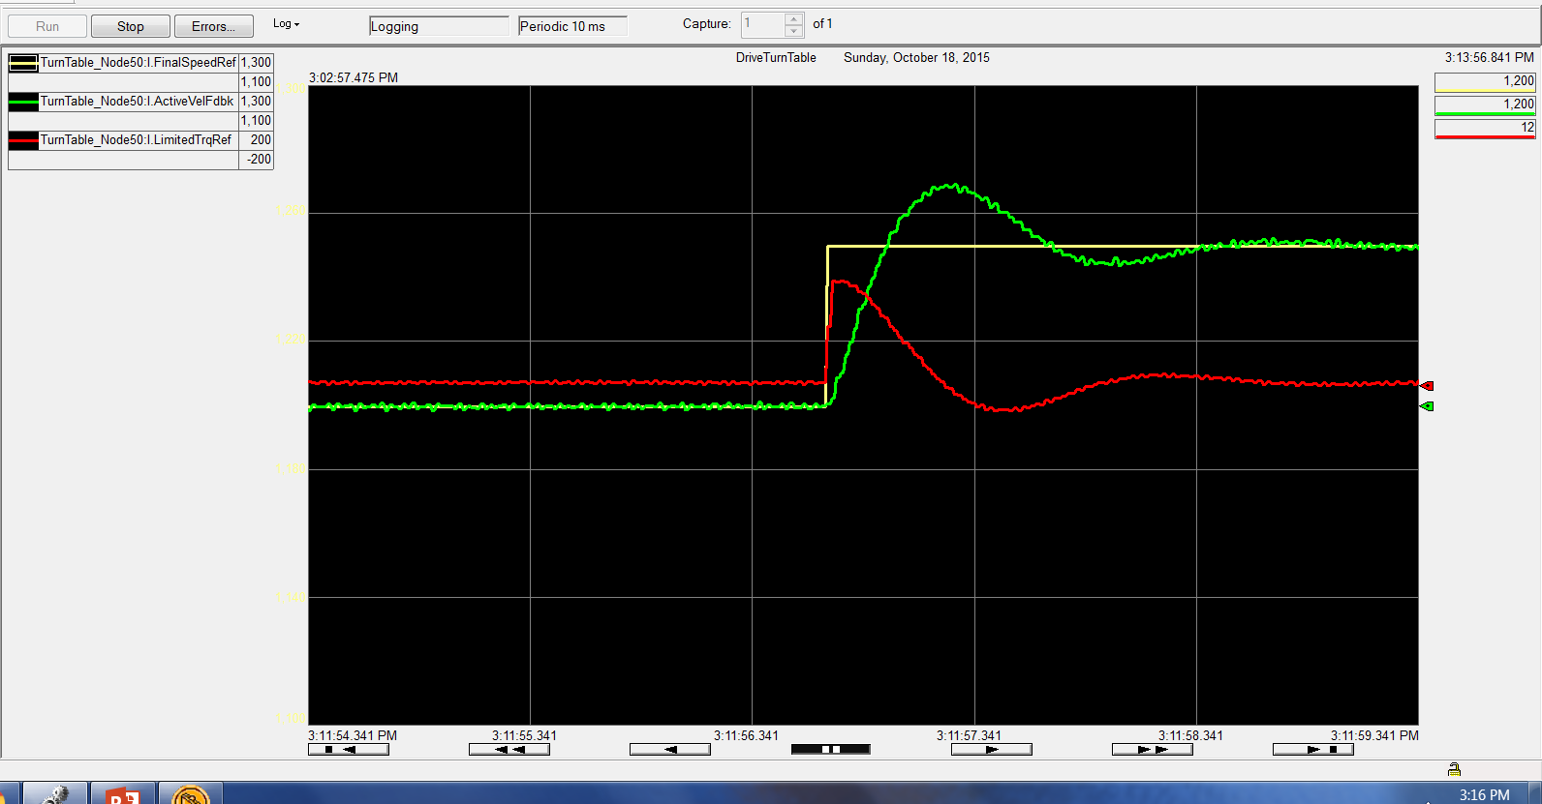
KP=20 KI=100
Notes:
Starting to ring over under. This is sometimes stated as the classical response ¼ of the overshoot

Slide 21
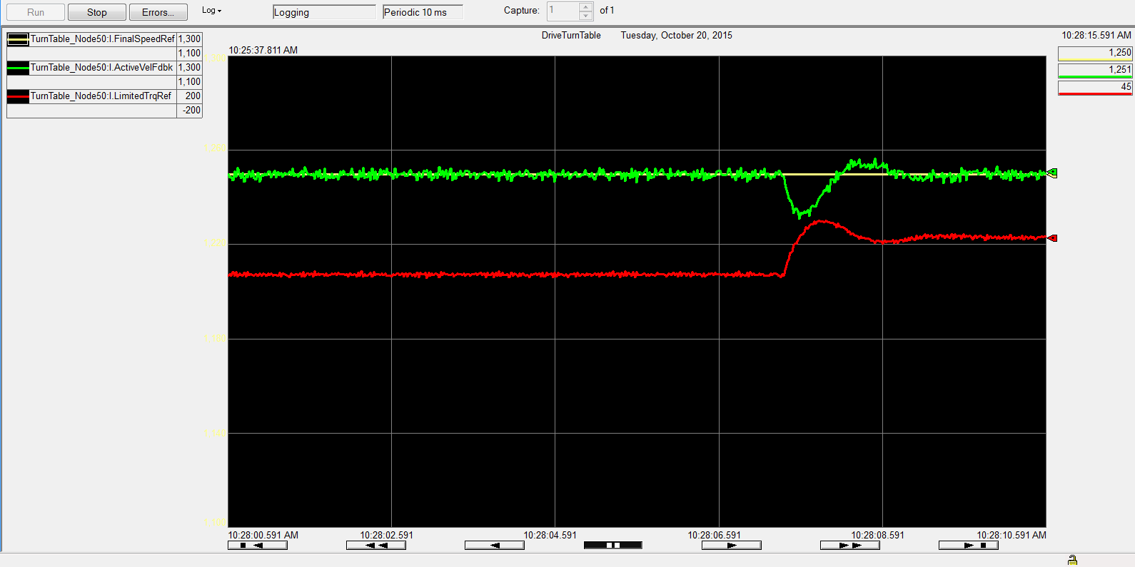
KP=20 KI=100
Notes:
ringing

Slide 22
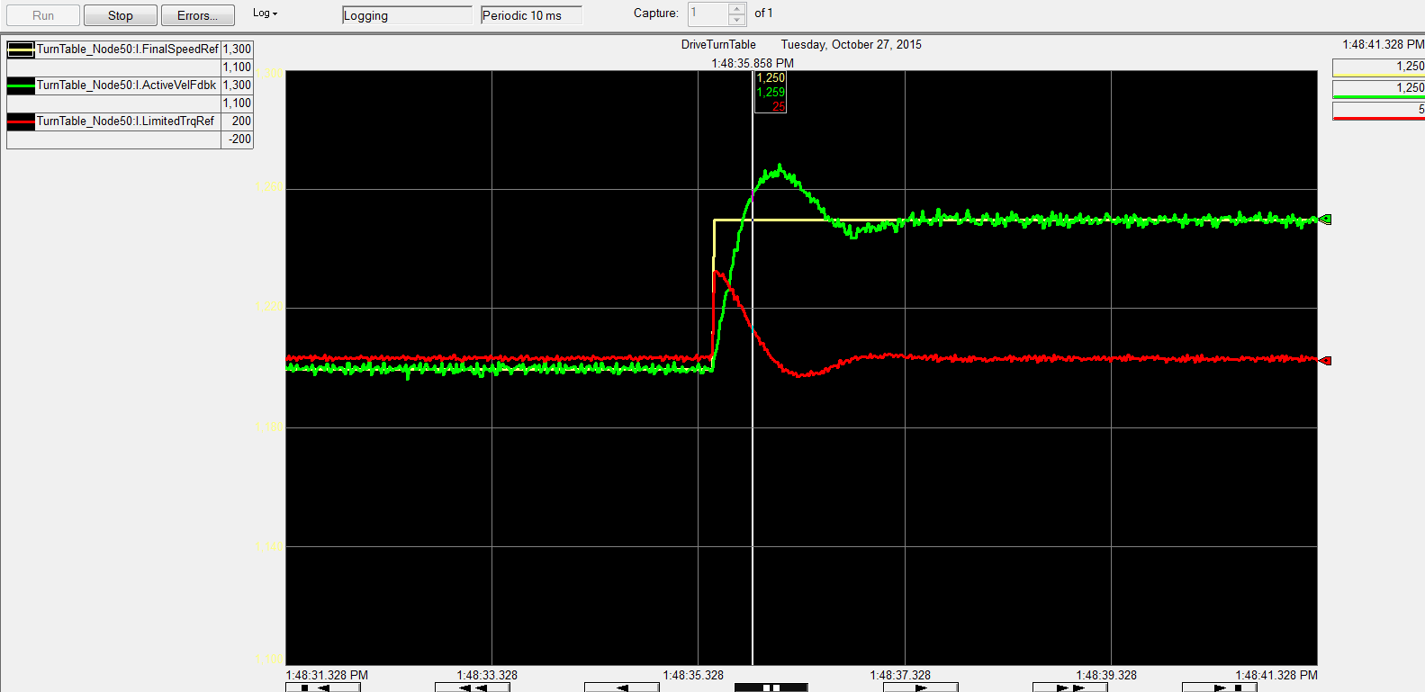
KP=20, KI=75
Notes:
Double half is the easiest way to tune 100+50)/2=75

Slide 23
KP=20, KI=63
Notes:
50+75)/2=63

Slide 24
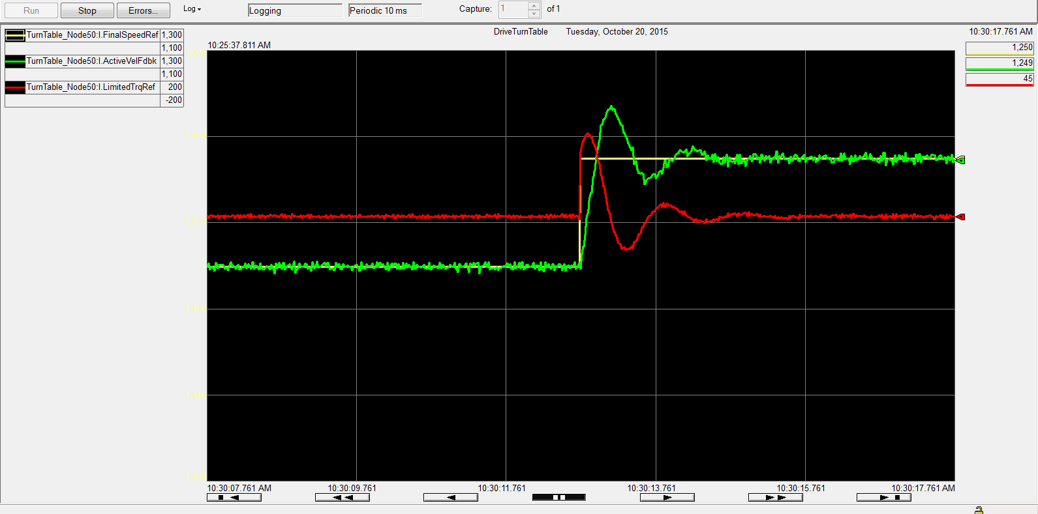
KP=20 KI=200

Slide 25
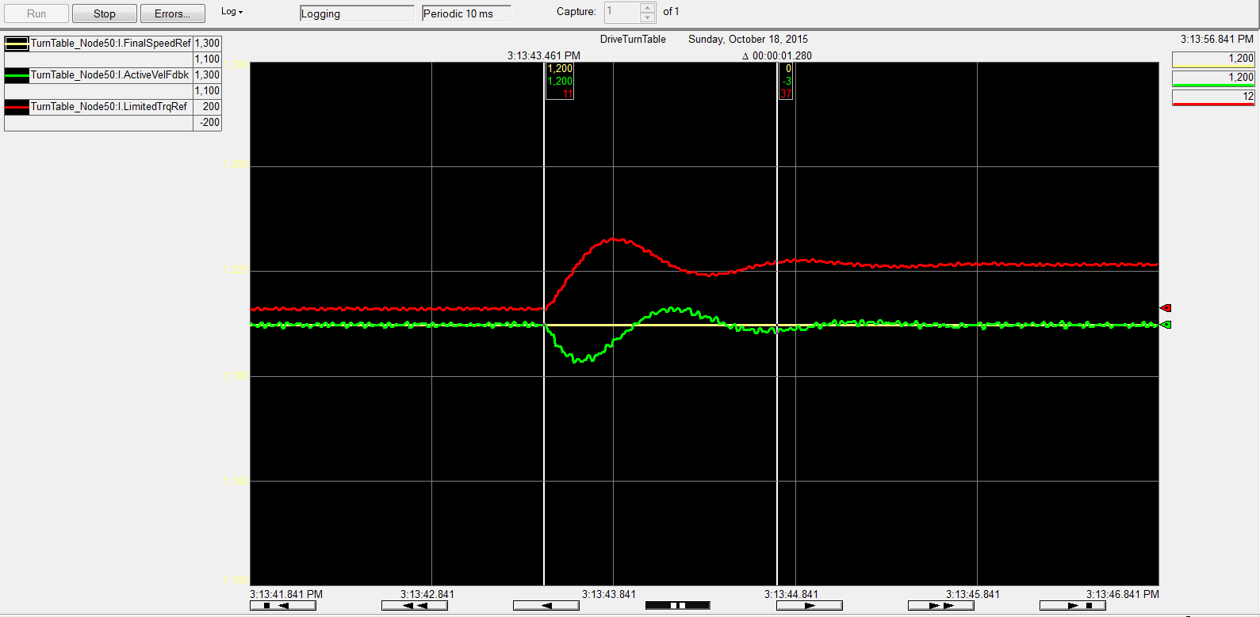
KP=20 KI=200

Slide 26
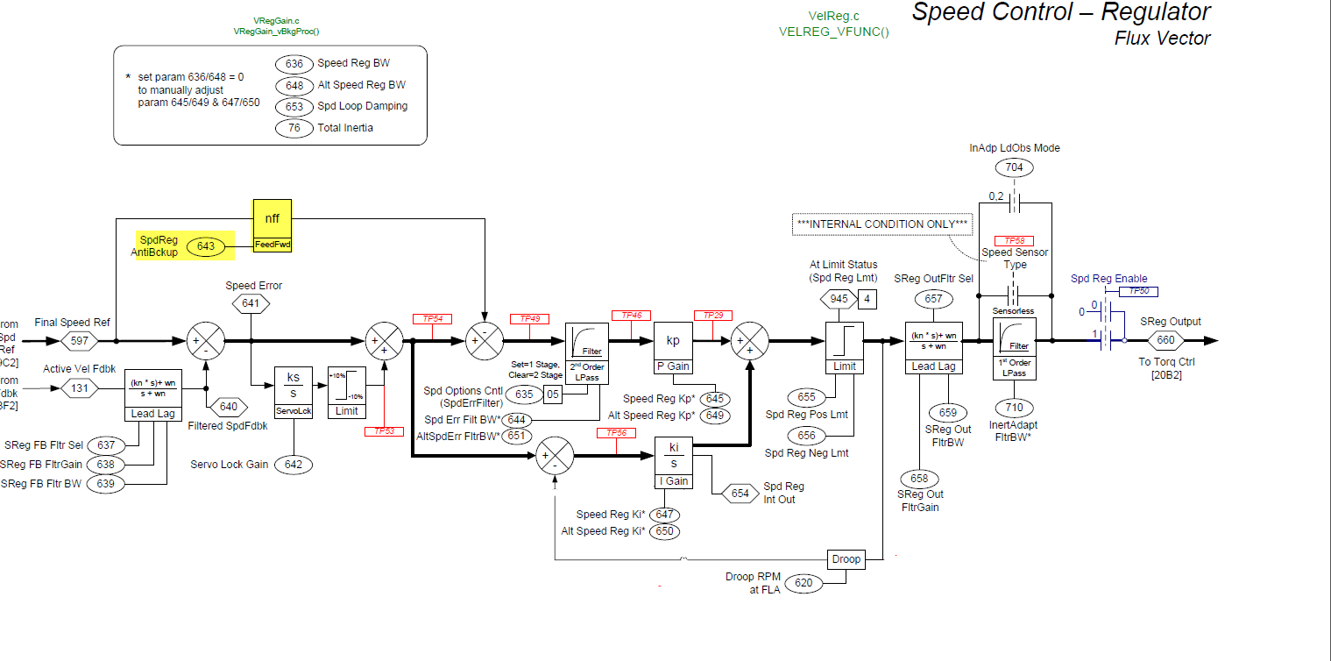
Negative FeedForward
Notes:
We like the response that integral gives us on the load response. But not on the speed reference change. So Nff (antibackup)

Slide 27
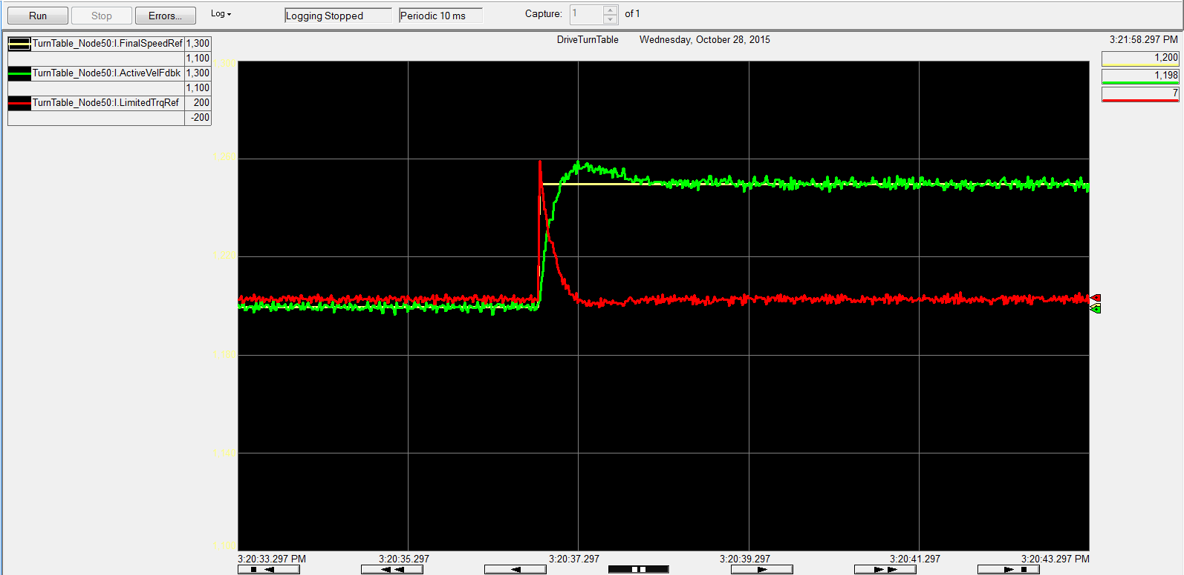
Negative Feedforward
KP=40 KI=63 NNF=0
Notes:
Doubled KP to try to drive the overshoot to zero (no success)

Slide 28
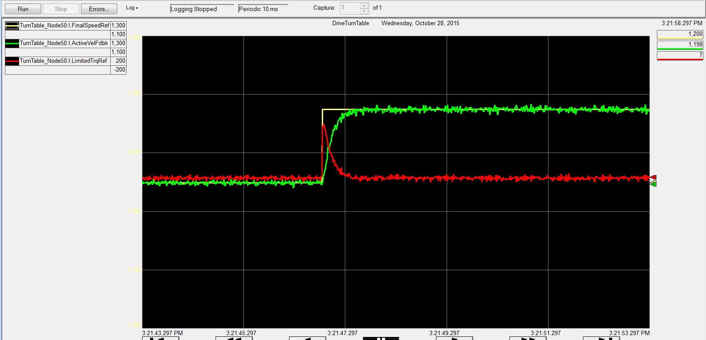
Negative Feedforward
KP=40 KI=63 NNF=0.3
Notes:
We are not showing the load response because they are the same. NFF only operates on the speed reference change.

Slide 29
Agenda
Basic Regulator: KP and KI
Frequency Response: Gain Calculations
Filters: FIR, Lead-Lag, Notch
Load Observer/Inertia Adaption
Position Loop
Notes:
Calculating KP/KI together

Slide 30
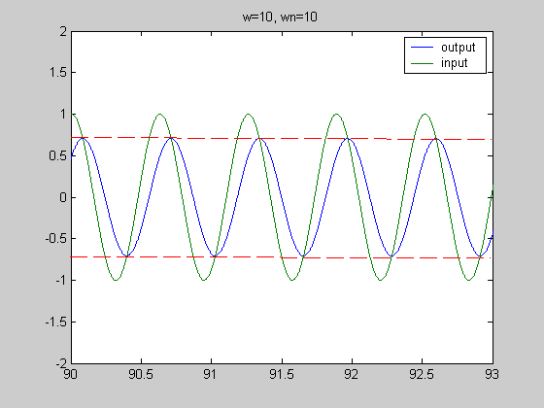
Frequency Response
Frequency Response: A method of investigating the characteristics of a linear system. A sinusoidal input to a linear system produces a sinusoidal output of the same frequency with a change in amplitude and phase shift.
Notes:
Allows the control engineer to see the response of all the frequencies
Allows for the proper alignment of filters

Slide 31
Bandwidth
There are many different definitions of Bandwidth
The inverse time it takes a system to reach 63.3% of its final value to a step input.
For 10 radians/second the time to get to 63.3% is 1/10 of a second
Time domain is 1/rad
2*pi rad/sec=1 Hz
This is also, known as the 3db point

Slide 32
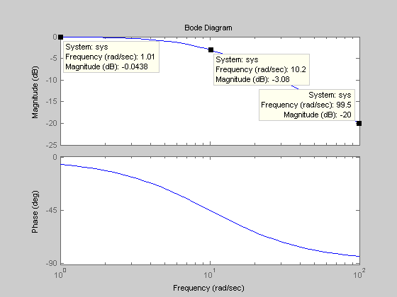
Bode Diagram Shows all Frequencies
Notes:
Bode Plot of a simple low pass filter
BW of filter is 10 radians/seconds
Inputs
1 rad/sec no attenution and little phase shit
10 radse/c 3db of attenuation, this is the half power point so the actual attenuation is 0.707
20 rad/sec 20 db of attenuation which is attenuation of 0.1

Slide 33
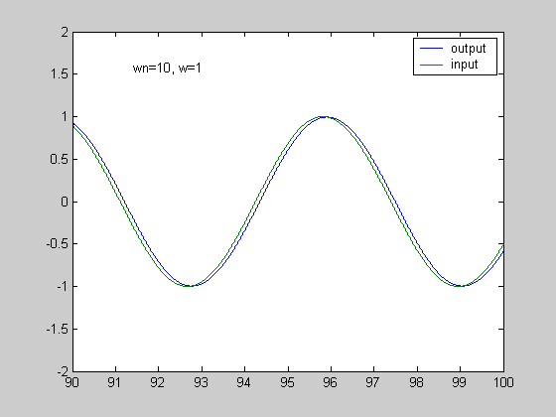
Input Frequency = 1 rad/second

Slide 34
Input 10 rad/sec wc=10 rad/sec
Attenuation: 0.707 Phase Shift 45 degrees
Notes:
The -3db point is the half power point\
20*log(A)=-3db
A=10^(-3/20)
A=0.707

Slide 35
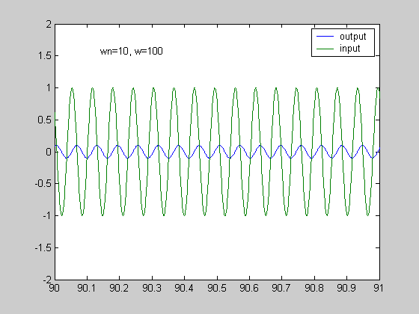
Input 100 rad/sec wco=10
0.1 Attenuation, 90 degree phase shift
Notes:
0.1 Attenuation 90 degree phase shift!!
Remember 180 degree shift is bad!
A=10^(-20/20)
A=0.1

Slide 36
Bode Diagram Shows all Frequencies

Slide 37
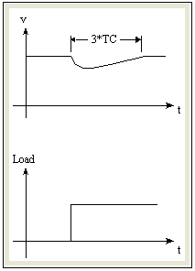
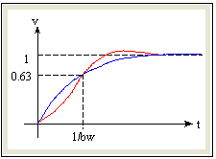
Regulators & Tuning – Gains
Bandwidth / Response
Basic Relationships
kp
J
Bandwidth
bw =
Proportional Gain
kp = bw * J
bw * kp
4 * ζ²
Integral Gain
ki =
kp
ki
4 * ζ²
bw
Load TC
TC =
=
Load Recovery time
Tr = 3 to 5 TC
Notes:
This is the relationship for tunning used by the 700S.
The 700S autotune function will record the system inertia for the user
The user than can use P90 Bandwidth and P91 system damping to adjust KP and KI
KP is strictly a function of Bandwidth and Inertia
KI is a function of Bandwidth Inertia and damping.
The Load Time constant is a relationship between Bandwidth and system damping

Slide 38
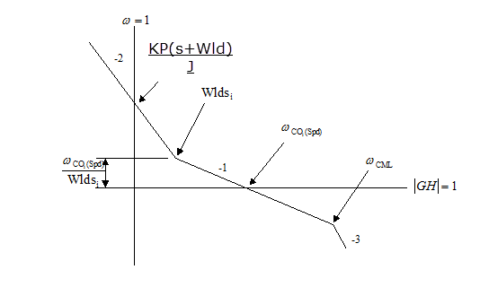
Regulator
Reference
KP
Output
(
s
+
Wld
)
+
s
F
e
e
d
b
a
c
k
J
s

Slide 39
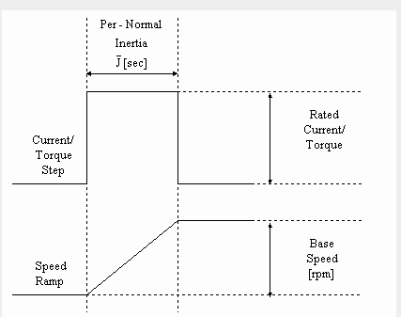
Inertia Test
System Inertia = 4.75

Slide 40
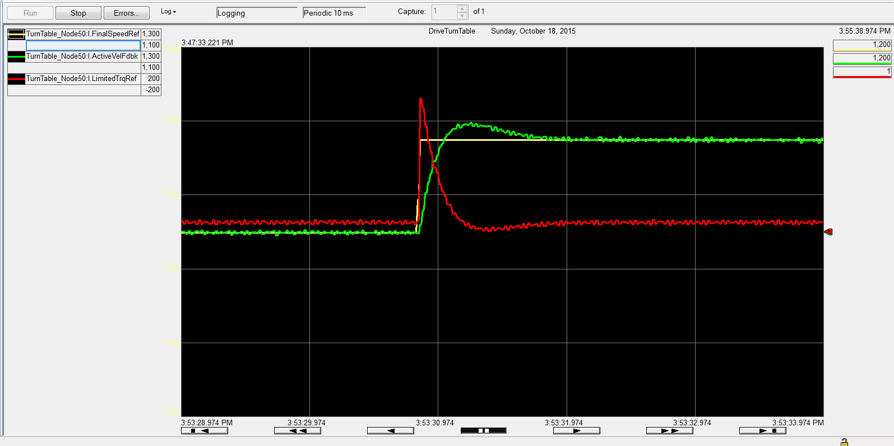
Speed Regulator BW=10

Slide 41
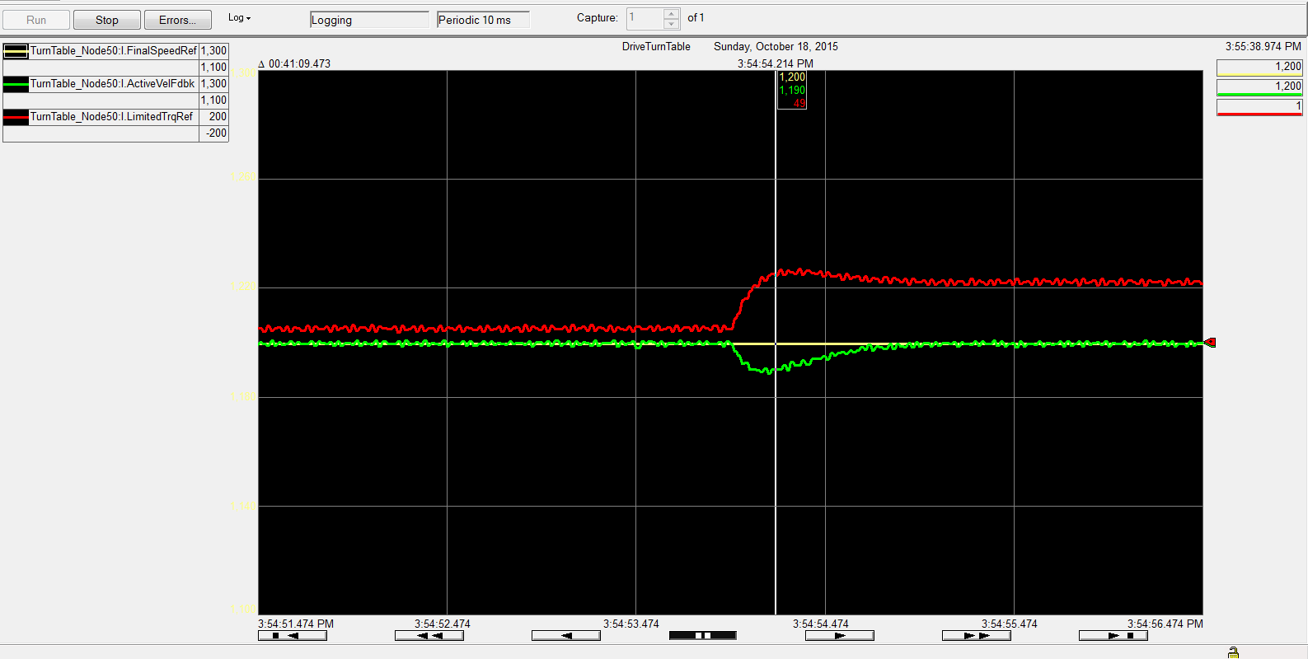
Speed Regulator BW=10

Slide 42
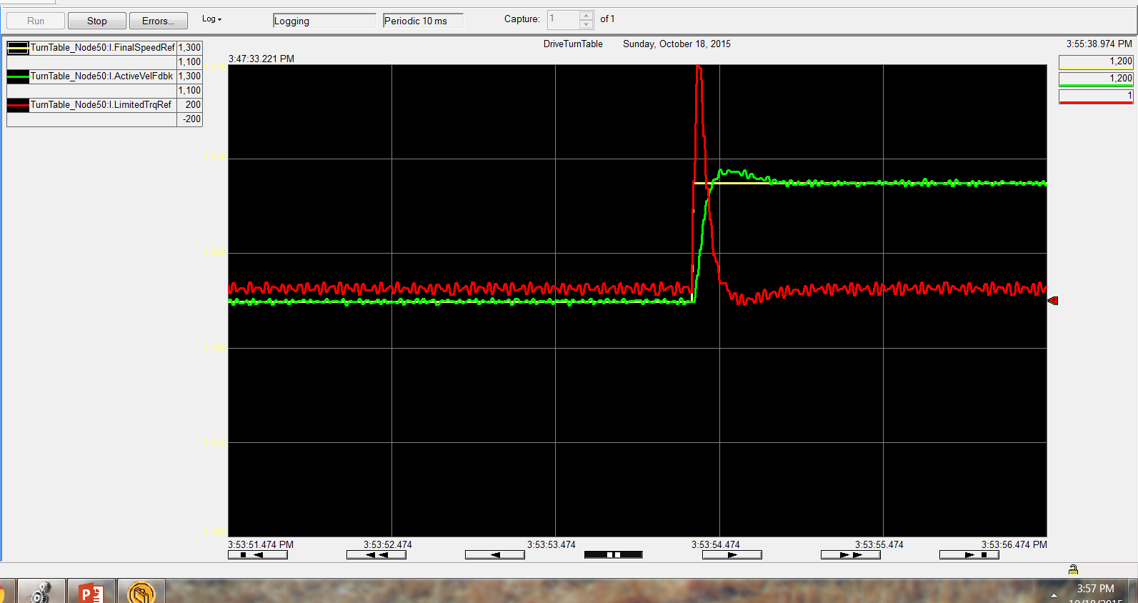
Speed Regulator BW=20

Slide 43
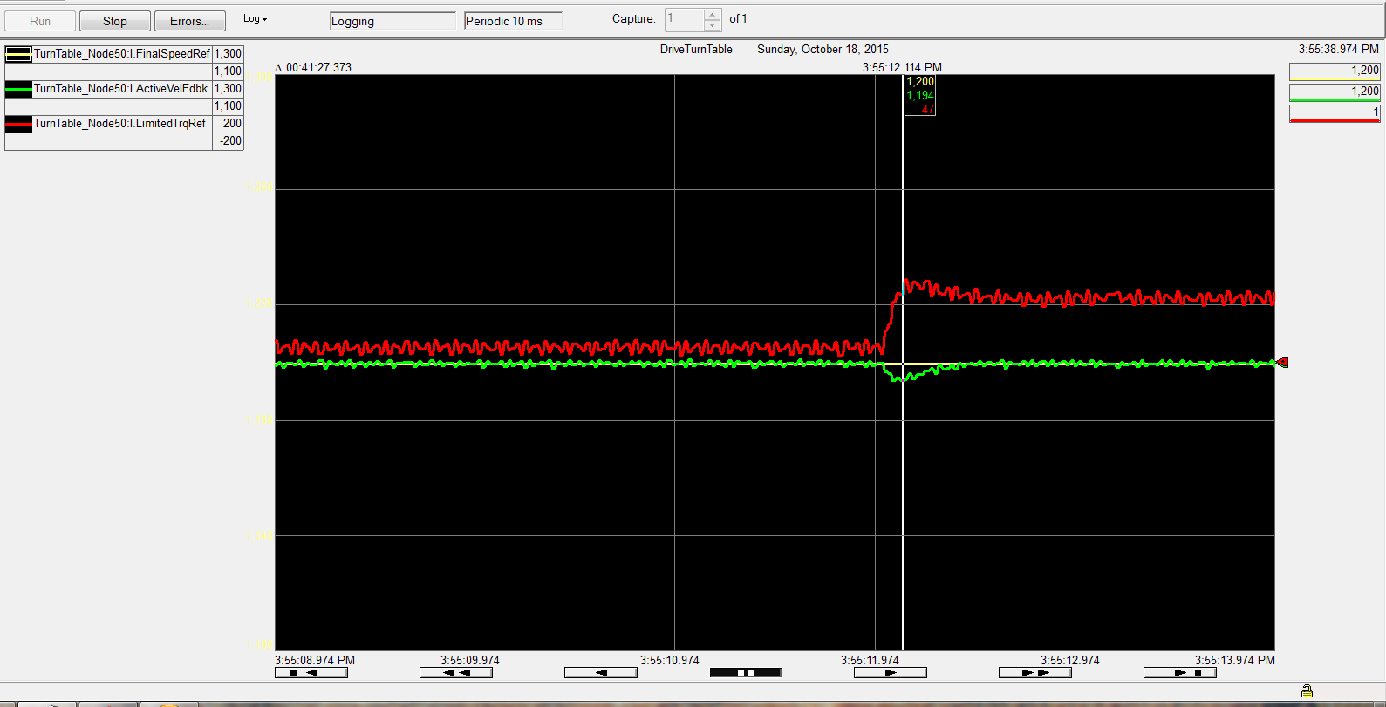
Speed Regulator BW=20

Slide 44
Speed Regulator BW=20

Slide 45
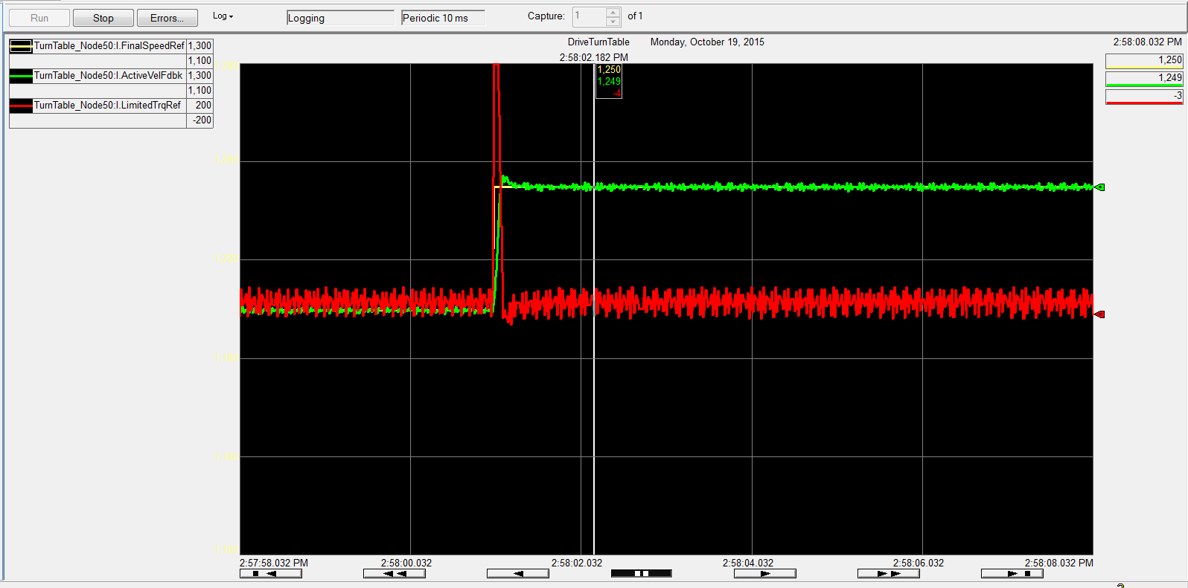
Speed Regulator BW=40
Notes:
Notice the ringing on the torque. Can your mechanical system handle it. Does the process require the response

Slide 46
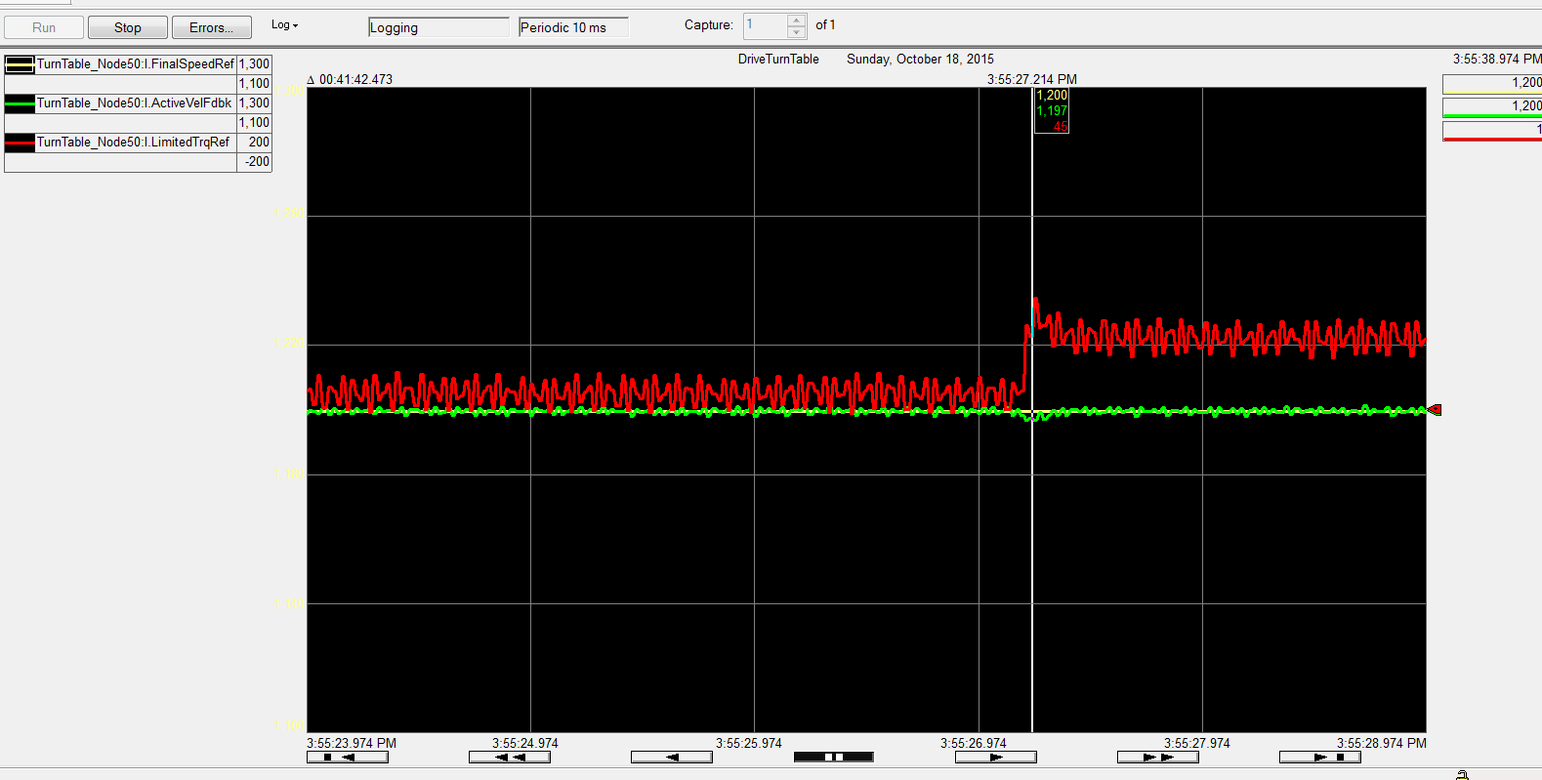
Speed Regulator BW=40

Slide 47
Agenda
Basic Regulator: KP and KI
Frequency Response: Gain Calculations
Filters: FIR, Lead-Lag, Notch
Load Observer/Inertia Adaption
Position Loop

Slide 48
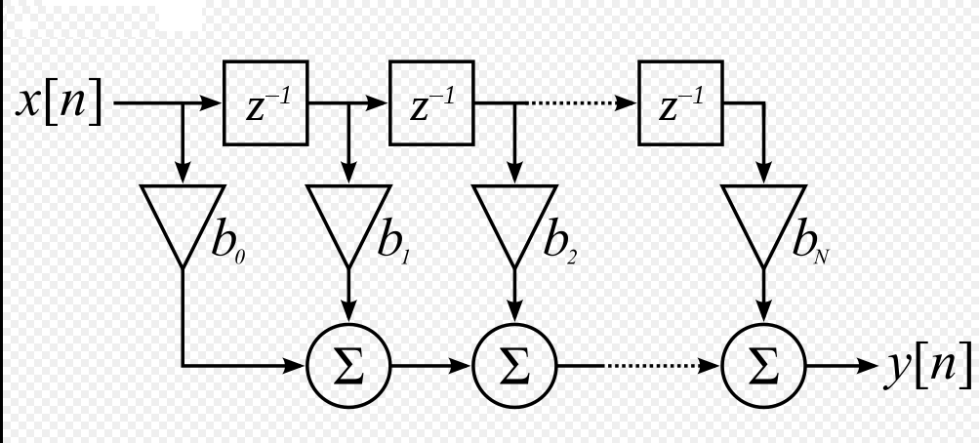
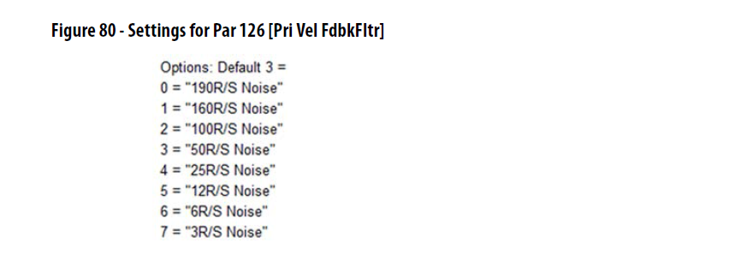
Encoder Feedback
Finite Impulse Response Filter (FIR)
Par 126 (Pri Vel FdbkFltr)
This becomes the maximum velocity Bandwidth!!!
Notes:
Remember from the bode plote, the more filtering the lower the phase marging

Slide 49
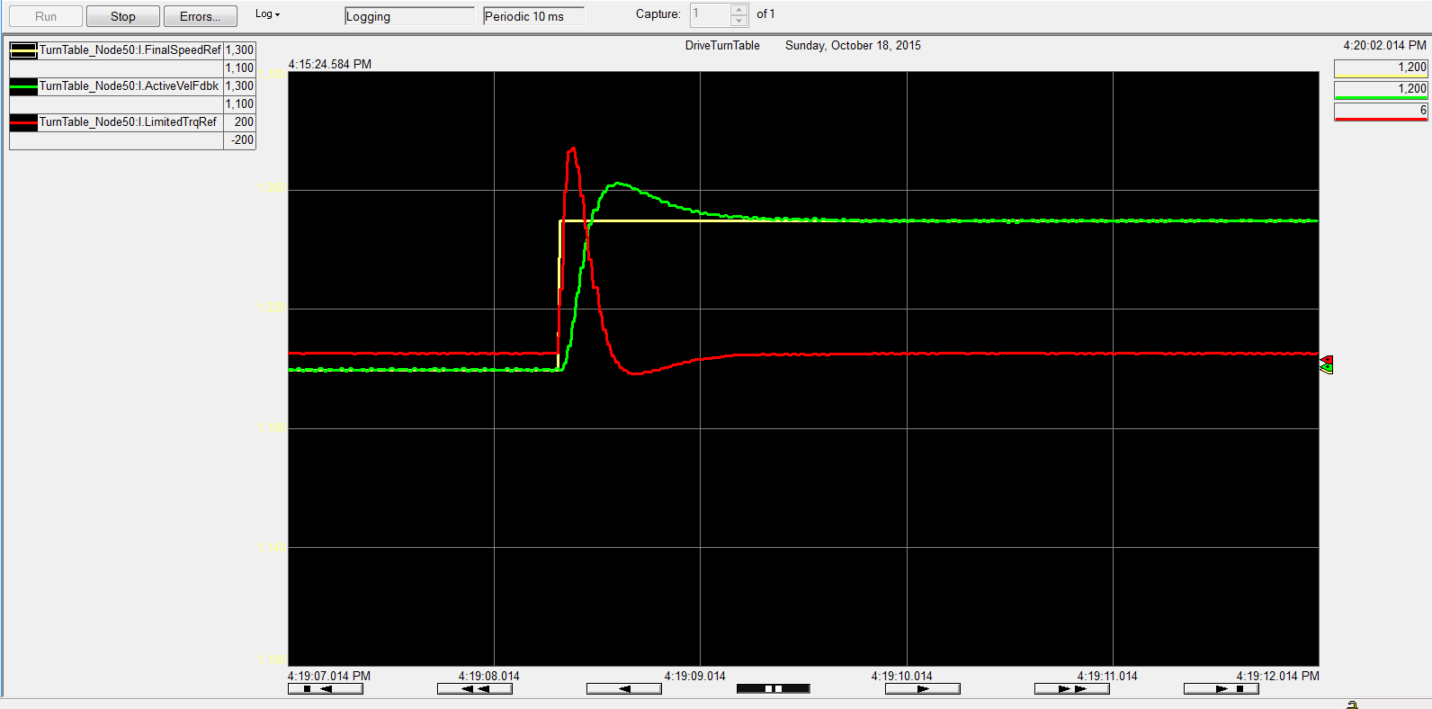
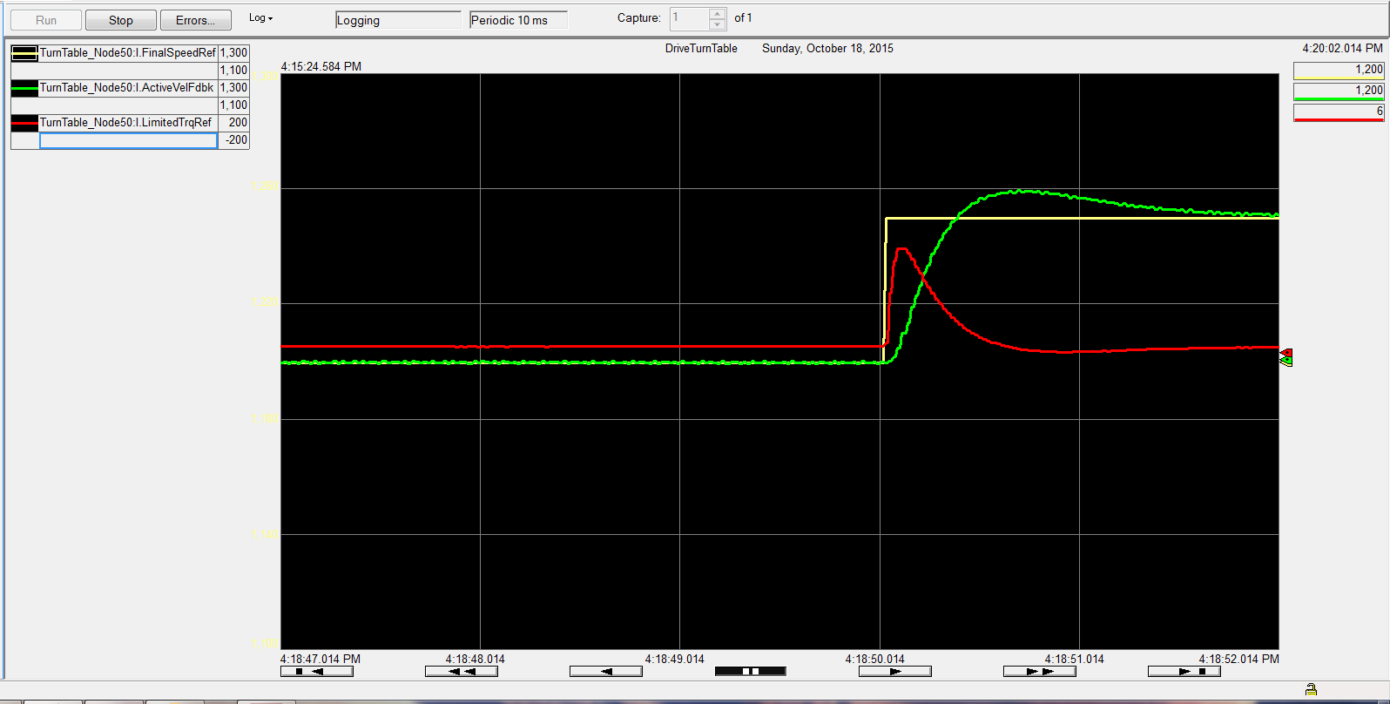
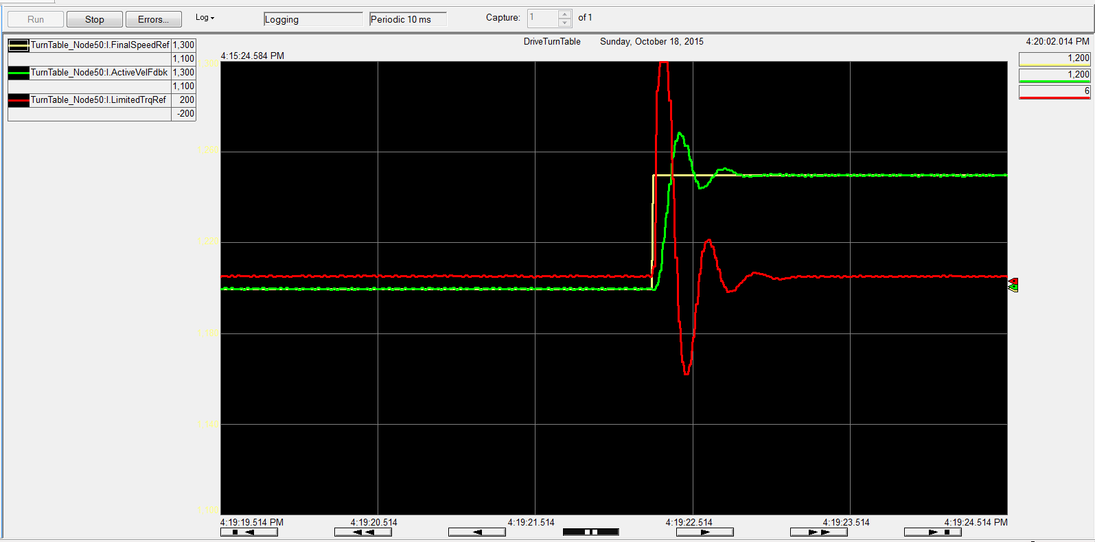
P125 at 12 rad/sec BW=5,10,20

Slide 50
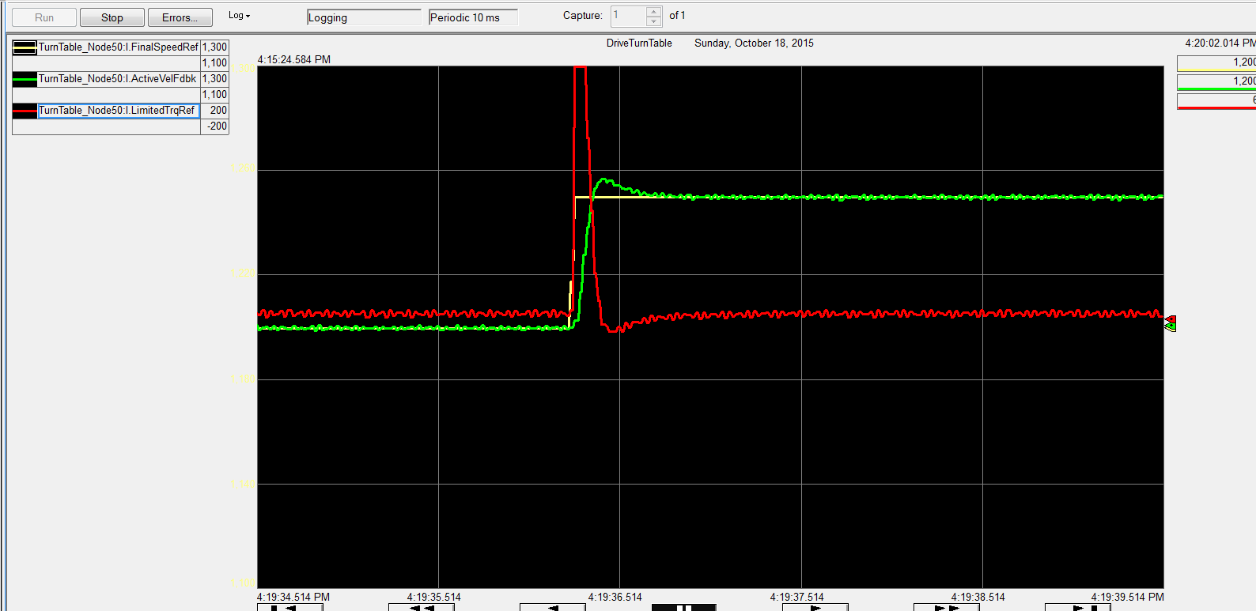
Changing P125
From 12 rad/sec to 50 rad/sec

Slide 51
Lead Lag Filter:
What is it?
The function of a Lead-Lag is to modify the gain of a system, at certain frequencies, to prevent unwanted frequencies from interacting with a drive regulator causing it to oscillate (become unstable)
A Lead-Lag function block can be used as simple low pass filter, a Lead-Lag or a Lag-Lead depending on the values chosen for the Lead and Lag frequencies.

Slide 52
Lead-Lag Compensation
  Lead-Lag filters can be used to compensate for mechanical problems, in a drive system
  The Lead-Lag is “tuned” to prevent the mechanical resonance from “exciting” the speed loop, causing the speed loop to oscillate
  Typically, there are two types of mechanical problems encountered in drive systems
    Backlash
    Torsional Resonance

Slide 53
Lead Lag Filter
Input
Output
Gain
BW
Gain of 1 Disables the filter
Gain Less than 1. the filter is a lag lead
Gain Greater than 1 the filter is a lead lag

Slide 54
Types of Mechanical Problems: Backlash
  Backlash
    Backlash is caused by play between the teeth in gears (gear box) or spines in a coupling
    The teeth “load” and “unload” as the motor changes speed, causing the teeth to “chatter”

Slide 55
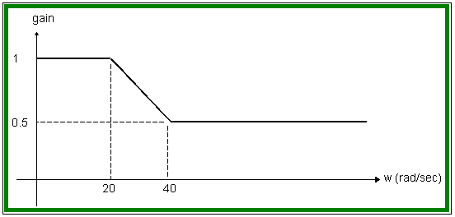
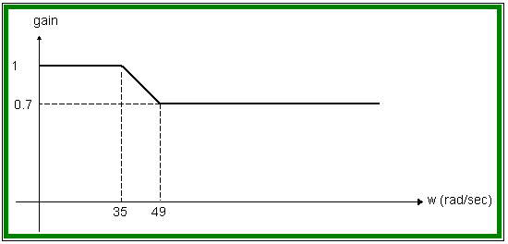
Regulators & Tuning - Lead/Lag Filters
Special purpose Lead / Lag Compensation
Light filtering: kn = 0.7, wn = 35
Application: Moderate gear noise reduction
Suggestion: Enable both lead lag filters
for increased noise reduction
Heavy filtering: kn = 0.5, wn = 20
Application: Aggressive gear noise reduction
Suggestion: Enable both lead lag filters
for increased noise reduction
Notes:
This is how to set the drive up to handle back lash
This is a generic slide
P93,P95=kn
P94,P96=wn

Slide 56
Bode Plot (kn=0.7 Wn=35)
Notes:
Bode Plot shows that all frequencies higher than 100 rad/sec will be attenuated .7
Phase shift is kept to a minimum and actually heads back to zero

Slide 57
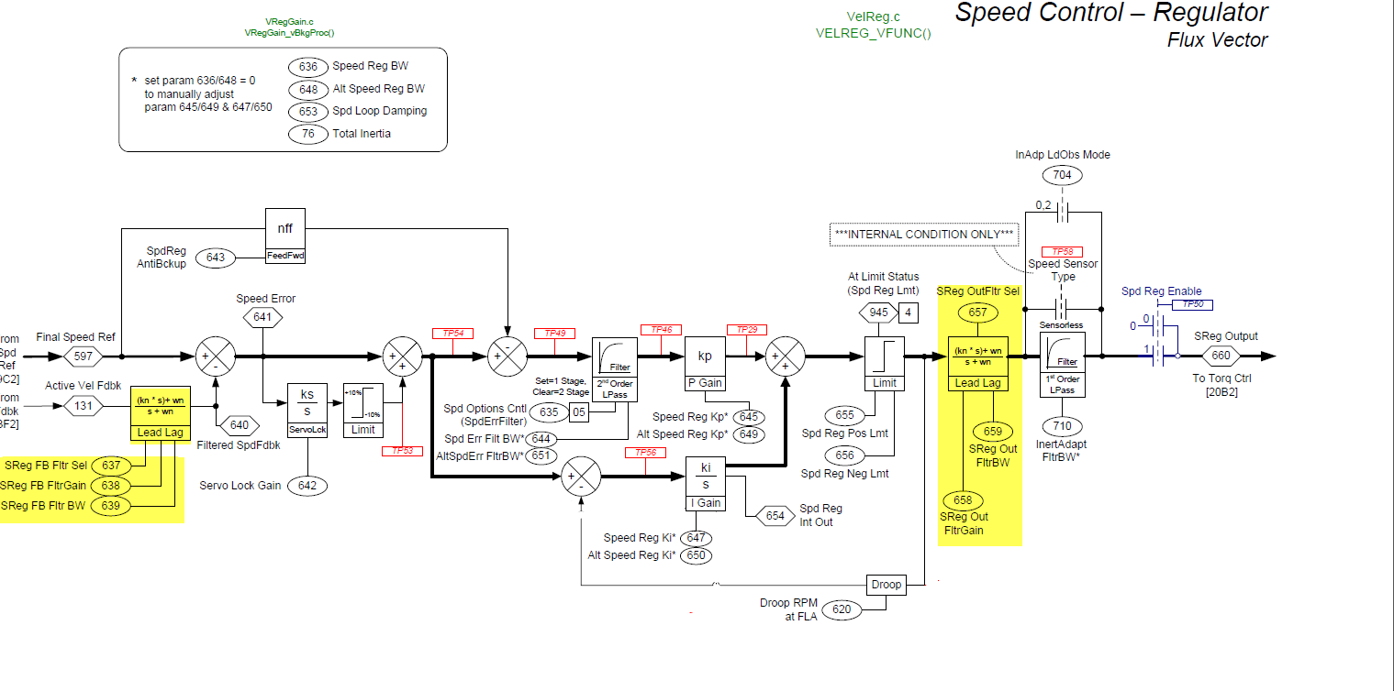
Velocity Lead Lag

Slide 58
Resonance Frequency
Size of the Inertia of the motor and roll
Stiffness of the coupling
Notes:
Resonance

Slide 59
No Comp
Notes:
Showing a system with no compensation

Slide 60
Reviewing Data
Looking at the chart, there is approximately 10 cycles per second (10Hz)
2*pi*f=rad/sec
Set wld=62 rad/sec
Set wlg=300 rad/sec
Kn=5
Wn=300
Notes:
Lets try a lead term to cancel the resonance
Or we can use the notch
Using the graph insert one can see aproximately 10 cycles per second
Set the lead to 62 radians

Slide 61
Using Lead-Lag Filter
Notes:
Using the lead term

Slide 62
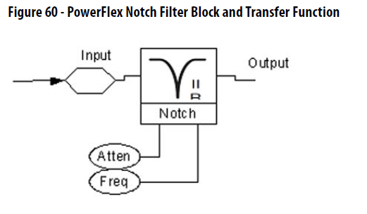
Notch Filter
Notch Filter Rejects a specific frequency
Most common notch filter is the one to remove the 60Hz buzzing from stereo speakers

Slide 63
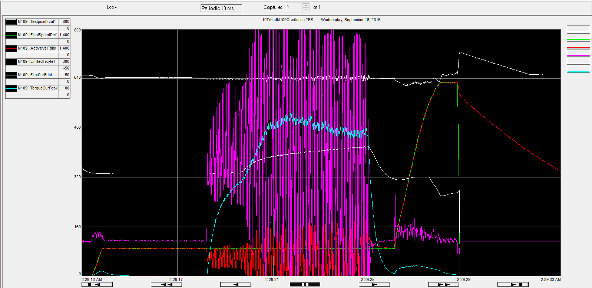
M109 Oscillation

Slide 64
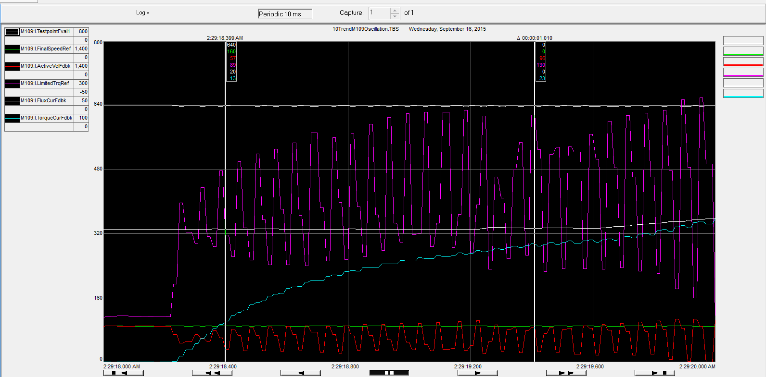
M109 Approx 18 cycles/second

Slide 65
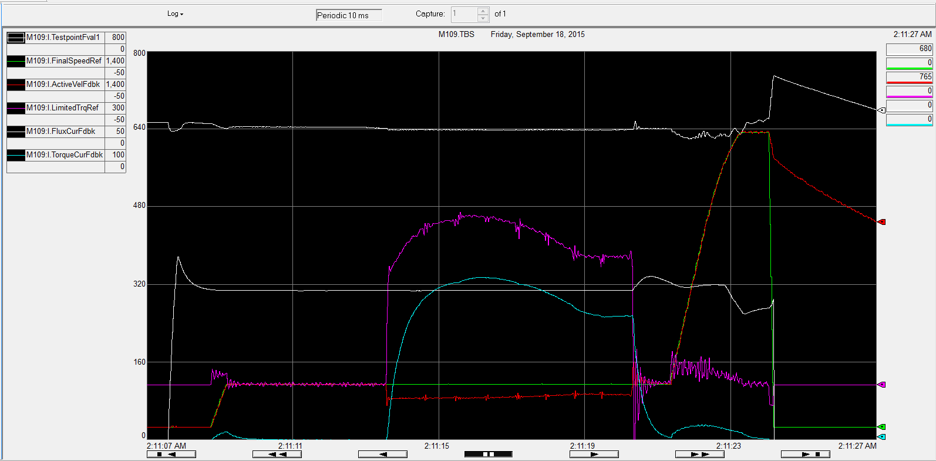
M109 18 Hz Notch

Slide 66
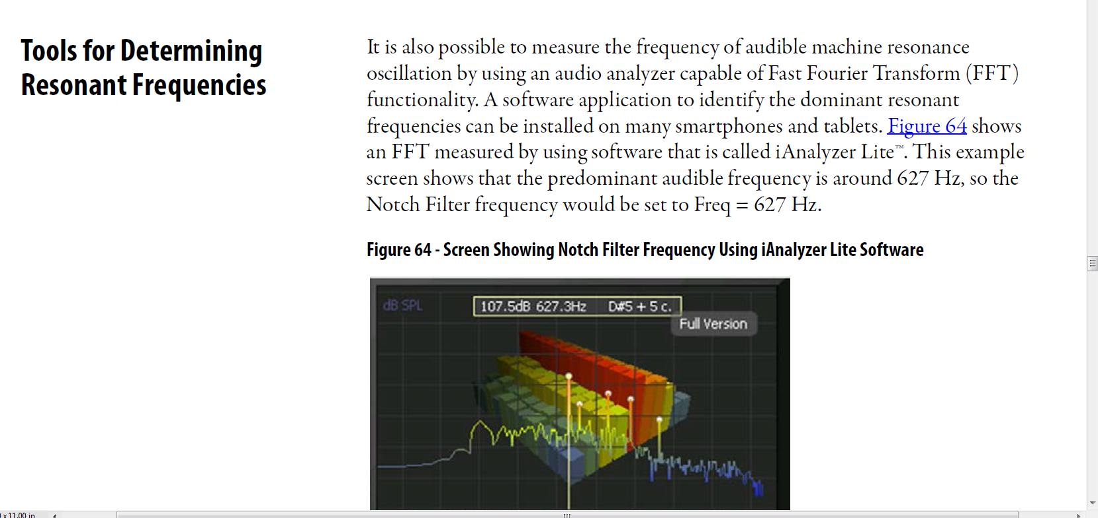
iAnalyzer
Notes:
For the milleniums out there, there is a cool app for your phone. The drives att004 explains it

Slide 67
Agenda
Basic Regulator: KP and KI
Frequency Response: Gain Calculations
Filters: FIR, Lead-Lag, Notch
Load Observer/Inertia Adaption
Position Loop

Slide 68
Load Observer
Estimates the mechanical load on the motor and compensates for it
  Doctor Blades on Paper Machines
  Boxes being thrown onto a conveyor belt
  Logs entering the saw
Uses the acceleration feedback and total inertia from the inertia test

Slide 69
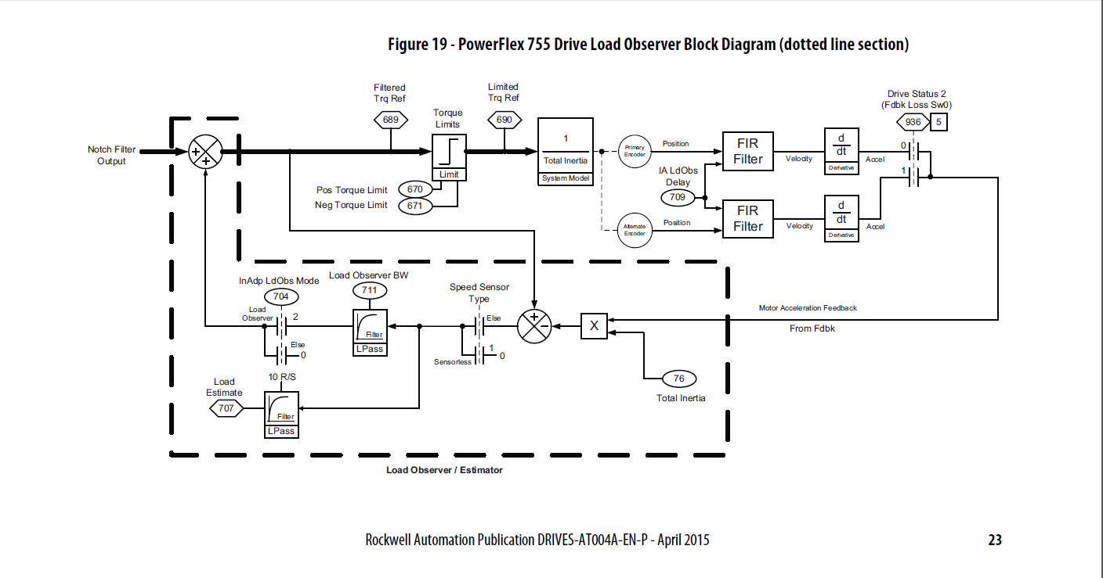
Load Observer
Notes:
Separate FIR

Slide 70


Load observer
Speed Regulator BW=10
Notes:
The load observer does all the work

Slide 71
Inertia Adaption
Notes:
This could be its own topic. And if you are interested please put it in the comment section

Slide 72
What Limits Bandwidth?
Processor Update Rate
  The faster the processor the greater the Bandwidth can be
Feedback Devices
  More resolution
  Noise on Feedback
But the number one limitation on Bandwidth is…..
Mechanical

Slide 73
Back Ground
Mechanical transmission connecting motor to load can limit bandwidth & performance of velocity regulator. Most noticeable in systems with large inertia ratios using gear-box or flex coupling. Load can suddenly become disconnected from motor as gear teeth become disengaged. System bandwidth can sore & system tends toward instability. Similar situation exists with flex couplings.

Slide 74
Types of Mechanical Problems: Backlash
  Backlash
    Backlash is caused by play between the teeth in gears (gear box) or spines in a coupling
    The teeth “load” and “unload” as the motor changes speed, causing the teeth to “chatter”

Slide 75

Resonant Frequency

Slide 76
Motor to Load Rato

Slide 77
Inertia Adaptation
Inertia Adaption increases system performance without using lead/lag or notch filters
Parameters a pre-calculated based on the system inertia and drive bandwidth.

Slide 78

Inertia Adaption Circuit

Slide 79
Accelerate with 150% Torque
Experimental Data Accelerate 150% load with Accel Time Programmed to 0.1
Accelerate 150% load with Accel Time Programmed to 0.1
Bandwidth = 100 , Inertia Adaptation = Enabled
Black Speed
Yellow Current
Red Torque
Accelerate 150% load with Accel Time Programmed to 0.1
Bandwidth = 100 , Inertia Adaptation = Disabled

Slide 80
Experimental Data:150% Shock Data
Enabled
Disabled
With Inertia Adaptation disabled the motor current and torque is installable.

Slide 81
Agenda
Basic Regulator: KP and KI
Frequency Response: Gain Calculations
Filters: FIR, Lead-Lag, Notch
Load Observer/Inertia Adaption
Position Loop

Slide 82
Inertia Adaptation

Slide 83
Agenda
Basic Regulator: KP and KI
Frequency Response: Gain Calculations
Filters: FIR, Lead-Lag, Notch
Load Observer/Inertia Adaption
Position Loop

Slide 84

Point to point position
Drive must be configured in a Flux Vector Mode
  Induction FV
  PM FV
  IPM FV
Drive Must have an encoder on the motor
Position Feedback must be set up

Slide 85

Simple Point to Point Application
Notes:
The speed reference and feedback followed each other until the drive needed to regen

Slide 86
Check the Following
Regen Power Limit (P426)
  Needs to be at least 200%
Negative Torque Limit (P671)
  Needs to be at least 100%
Positive Torque Limit (P670)
Bus Regulation Mode (P372)
  Needs to be Dynamic Brake
  Bus Regulation Mode set to adjust frequency!!!

Slide 87


Next Attempt there is an overvoltage!!
Overvoltage and dynamic brake temp

Slide 88
Dynamic Brake
P382 DB Resistor Type External
P383 DB Ext Ohms
P384 DB Ext Watts
P385 DB ExtPulseWatts
Sets the thermal transient response of the external dynamic brake resistor defined by the maximum allowable power to the dynamic brake resistor for 1 second without exceeding the resistor’s element temperature.
Joules or Watt Sec
Resistor Manufactures Know this number and will give it to you

Slide 89

Speed Regulator 40 rad/sec KPp=2
Notes:
The position loop is also scaled such that 1 per unit of error is equal to the position traveled when the motor is running at base speed. 1780 rev/min=29.6 rev

Slide 90

Speed Regulator 40 rad/sec KPp=8

Slide 91
Good Manual: Drives-AT004A

Slide 92
Agenda
Basic Regulator: KP and KI
Frequency Response: Gain Calculations
Filters: FIR, Lead-Lag, Notch
Load Observer/Inertia Adaption
Position Loop

Slide 93
Speed Regulator Parameters
Parameter Name/Function | PF700S | PF750 | PF700VC | PFDC
Total Inertia/System Inertia | 9 | 76 | 450 | 434
Speed Regulator BW | 90 | 636 | 449 | 435
Speed Regulator Damping | 91 | 653 |  | 436
Speed Reg P Gain | 81 | 645 | 446 | 87
Speed Reg I Gain | 82 | 647 | 445 | 88
Speed Error LPF | 89 | 644 | 448
Speed Reg FB Filt Sel |  | 637
Speed Reg FB Filt Gain | 93 | 638 |  | 238
Speed Reg FB Filt BW | 94 | 639 |  | 239
Speed Reg Output Filt Sel |  | 657
Speed Reg Output Filt Gain | 95 | 658 |  | 238
Speed Reg Output Filt BW | 96 | 659 |  | 239
Speed Reg AntiBckup | 84 | 643 |  | 643

Slide 94
Inertia Adaption Parameters
Parameter name function | PF700S | PF755
Inertia Adapt Select | 132 | 704
Inertia Adapt BW | 133 | 705
Inertia Adapt Gain | 134 | 706
Load Observer Delay |  | 709
Inertia Adapt Filter |  | 710
Load Observer BW |  | 711

Slide 95
Questions
Tech Support is a team
My colleague, Steve Wirtz has been correlating your questions
Will answer some of them and the remainder we will put in the question and answer portion

